Slide 1


Massachusetts General Hospital Performance Analysis
(DEPI – Power BI Track 2025)

Slide 2

Introduction & Project Scope
Project's goal:
To analyze the operational and financial performance of Massachusetts General Hospital using an interactive Power BI dashboard.
The analysis focuses on identifying patterns in admissions, encounters, procedures, and revenue to evaluate hospital efficiency and patient care outcomes.
The findings highlight areas of excellence and improvement for academic and administrative review.

Slide 3


Introduction & Project Scope
Target Audience:
1. Clinical Director: Uses the dashboard to monitor care outcomes and readmission trends. 2. Hospital Administrator: Tracks patient flow, occupancy, and departmental efficiency. 3. Finance Officer: Assesses profitability and cost control. 4. Data Analyst: Leverages data models to predict performance trends.

Slide 4


Methodology & Work Plan
Data Preparation: Import hospital data into Power BI, clean, and model relationships between tables (patients, admissions, procedures, and payers).
2. Measure Creation: Develop DAX measures for KPIs such as average Total Encounters, Total Procedures, length of stay, and Patient Count.
3. Dashboard Design: Create interactive pages (Landing, Encounters, Procedures, Revenue, and Demographics).
4. Testing: Validate calculations and KPIs for accuracy.
5. Documentation & Presentation: Compile academic and professional reports for final evaluation.

Slide 5
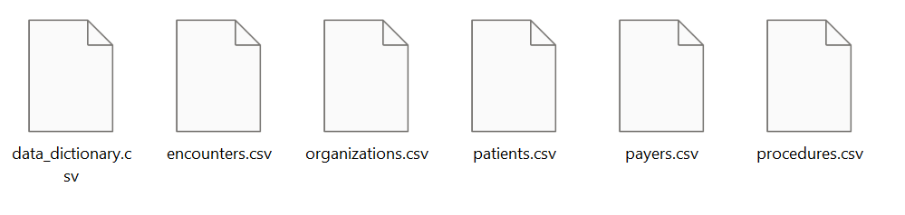
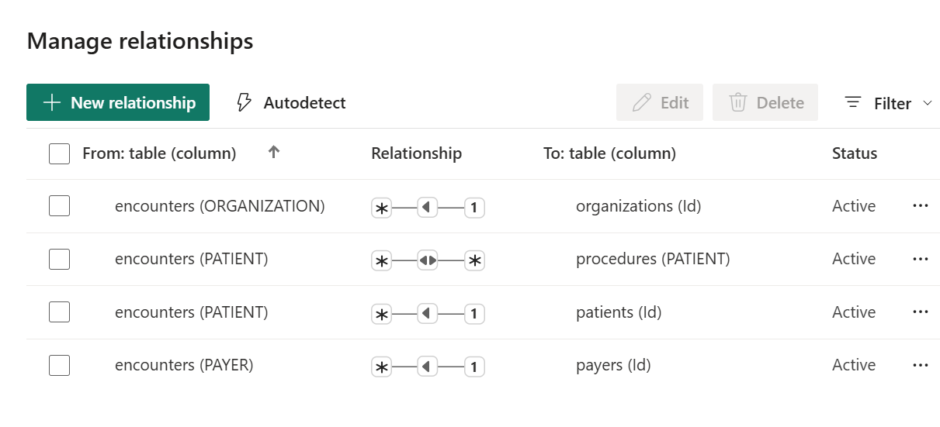
Data Preparation
Data for patients of Massachusetts General Hospital from 2011 to 2022

Slide 6
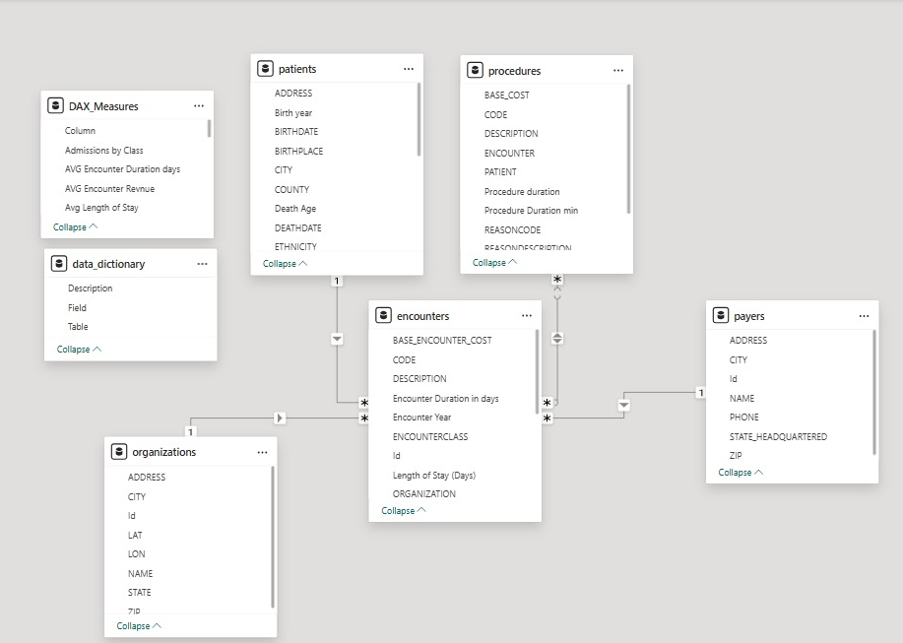
Star Schema
1 Fact Table
4 Dimensional Tables

Slide 7

Introduction & Project Scope
The Dashboard consists of four sections:
Encounters: Tracking the total admission, duration, volume (974 unique patients), categories of patient entries, and financial outcomes (revenue/cost) of patient visits.
Procedures: Evaluating the efficiency (duration), volume (39K), and financial returns (revenue/cost) of medical interventions.
Revenue: Breaking down the total financial intake and correlating it with costs, payer coverage, and patient burden.
Patient Demographics: information on patient demographics, gender, and insurance coverage.

Slide 8

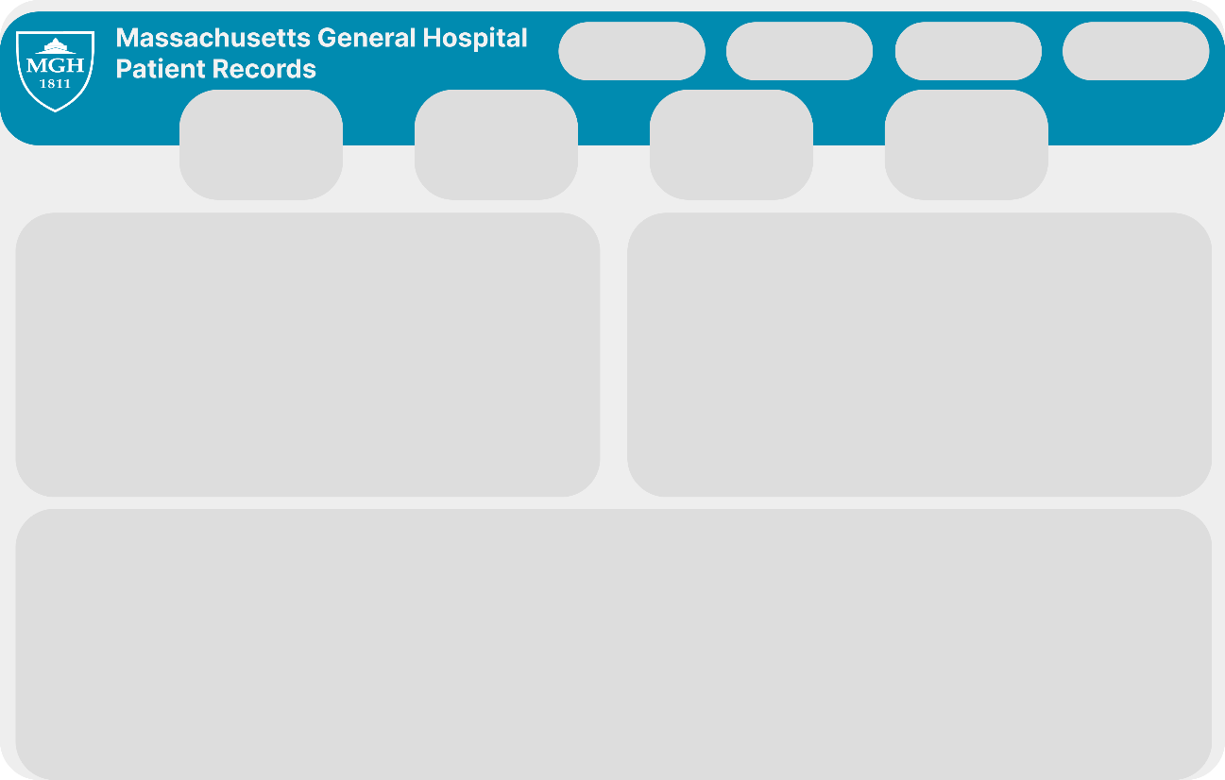
Dashboard Design & Visual Identity

Slide 9
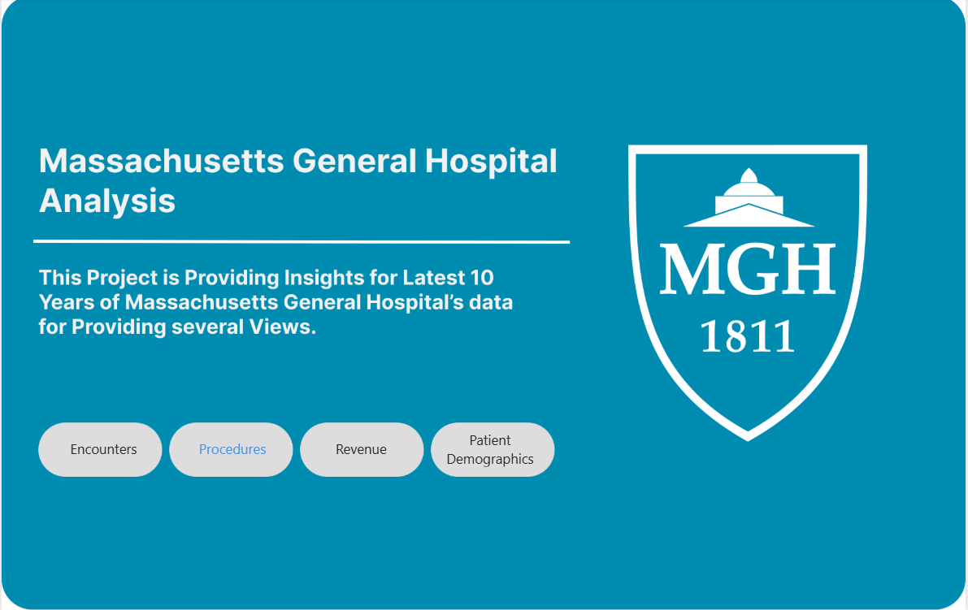
Dashboard Design & Visual Identity
1. Landing Page
Overview of Dashboards (Encounters, Procedures, Revenue, and Patient Demographics)

Slide 10
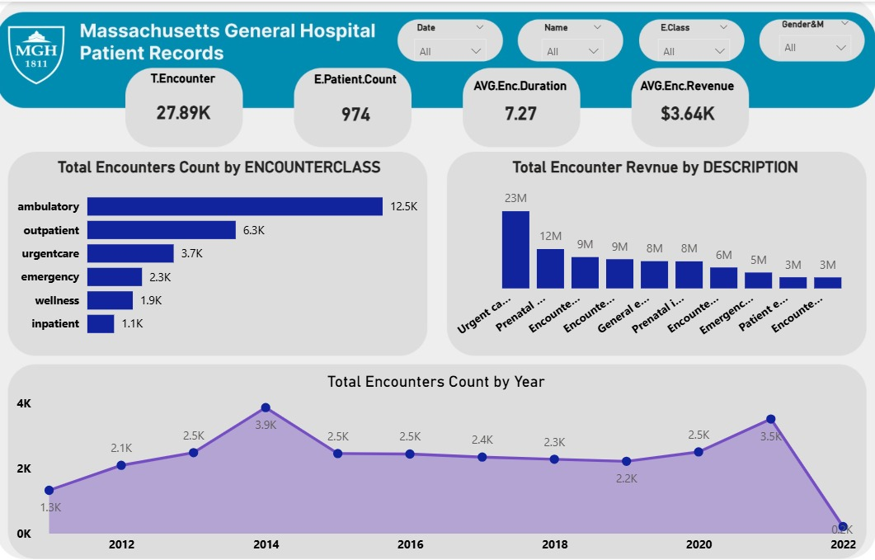
Dashboard Design & Visual Identity
2. Encounters Page
Displays encounter trends and durations.

Slide 11
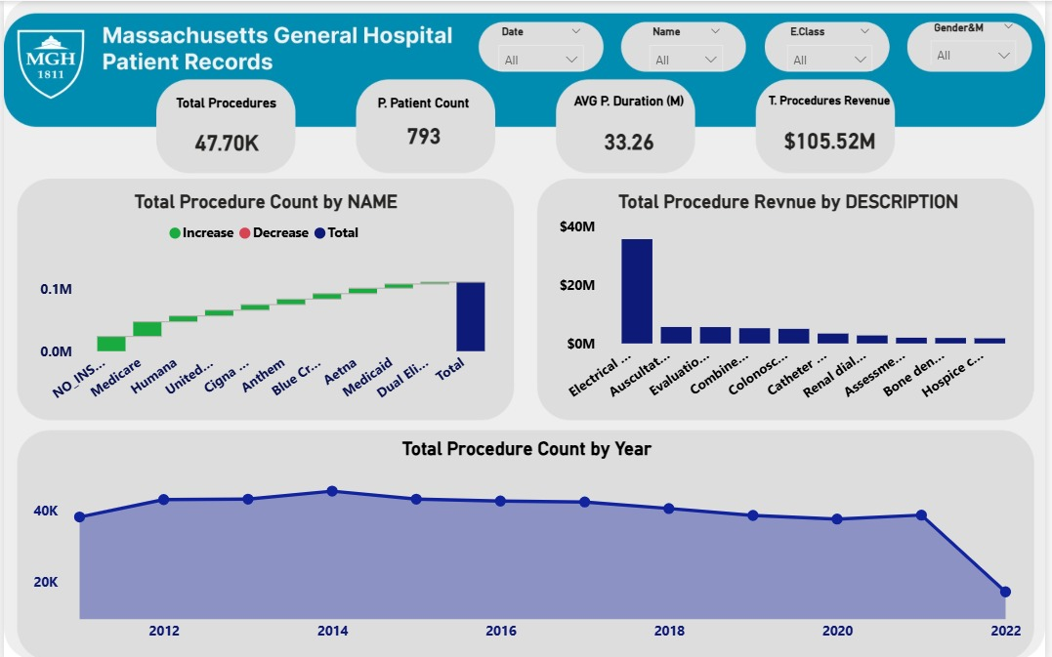
Dashboard Design & Visual Identity
3. Procedures Page
Shows frequency, costs, and outcomes of procedures.

Slide 12
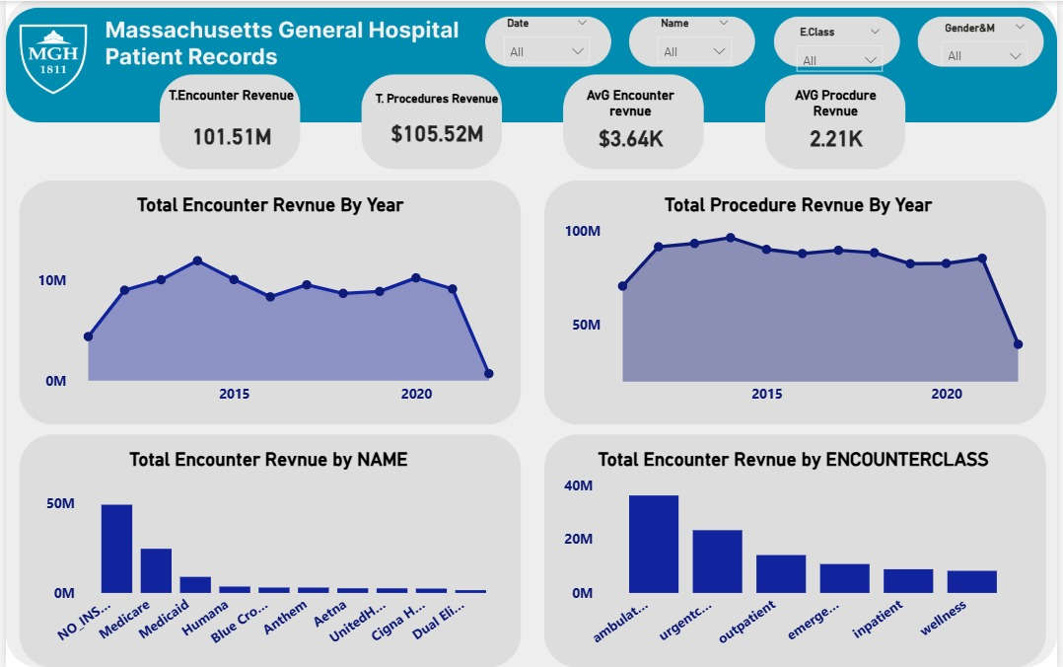
Dashboard Design & Visual Identity
4. Revenue Page
Breaks down revenue by payer and service line.

Slide 13
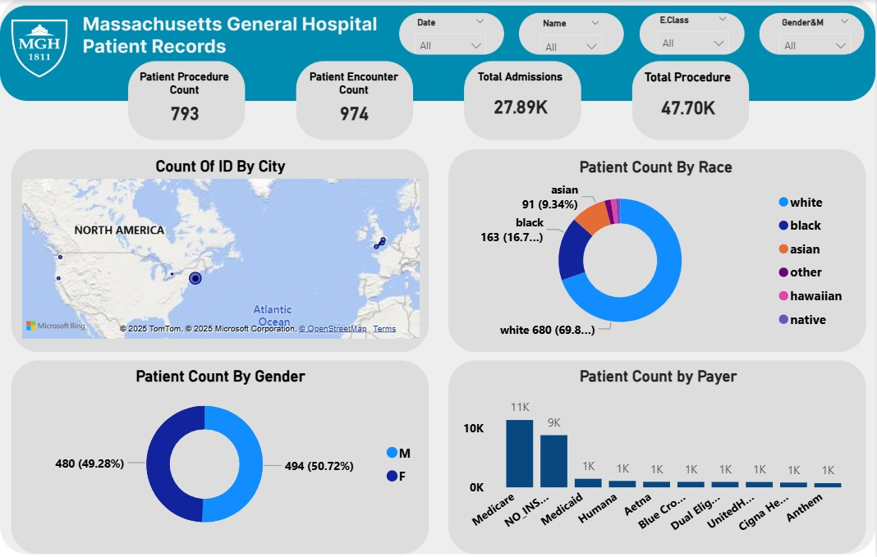
Dashboard Design & Visual Identity
5. Patients’ Demographics
Displays age, gender, and regional breakdowns.

Slide 14

Key Performance Indicators (KPIs)
Operational Efficiency:
Highlight successful operational metrics:
High Throughput: Total Admissions (28K) and Total Procedures (39K).
Procedure Efficiency: Avg. Procedure Duration (34.32 min).

Slide 15

Financial overview:
Balanced Finances: Total Encounter Revenue equal ($101.51M), indicating tight financial control.
Strong Return: Avg. Procedure Revenue ($2.21K).
Key Performance Indicators (KPIs)

Slide 16
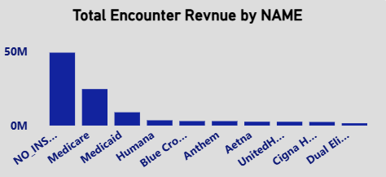
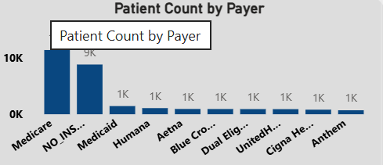
Conclusion & Recommendations
Actionable Recommendations:
🔹 Encounters Analysis
Findings:
Top Revenue Source: Patients without insurance generated the highest revenue ($49M) from 9K encounters.
Lowest Revenue Source: Medicare also had around 9K encounters but generated only $25M in revenue — nearly 50% less.
Recommendations:
Increase Insurance Utilization Optimize Medicare Services Patient Outreach Campaign

Slide 17
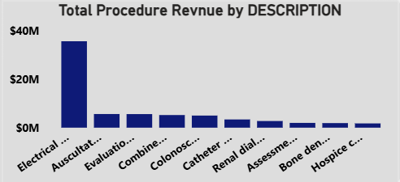
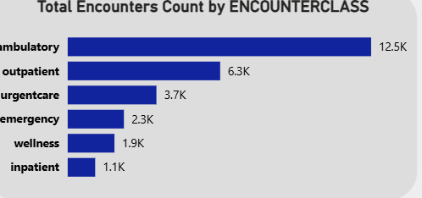
Conclusion & Recommendations
Actionable Recommendations:
🔹 Admissions & Encounter Types
Findings:
Lowest Admission Categories: Wellness and Inpatient encounters show lower volumes compared to outpatient or emergency services.
High Throughput: Total admissions are 28K, and total procedures are 39K are performed, with an average procedure duration of 34.32 minutes.
Recommendations:
Promote Preventive and Wellness Care
Boost Inpatient Services Efficiency Balance Patient Flow
🔹 Procedures Analysis
Findings:
Top Procedure by Profit: ElectroCardioversion (highest revenue contribution).
Lowest Procedure by Profit: Hospice care (least profitable).
General Trend: High-volume procedures may not always yield proportional profits due to cost or duration inefficiency.
Recommendations:
Expand Profitable Procedures Develop Low-Profit Areas Efficiency Optimization

Slide 18
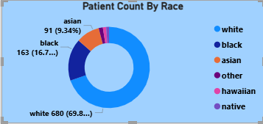
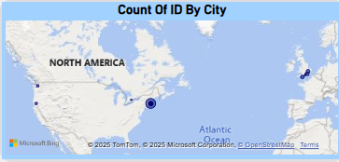
.
Findings:
Strong skew toward a single group. Nearly 70% of patients are White; the three next groups make up about 30% combined. That suggests limited racial diversity in your patient mix (or incomplete capture of race data).
Under-representation or low capture of smaller groups. “Other / Hawaiian / Native” together are only ~4% — either these populations are very small in your service area, or they are under-reached or under-recorded.
Recommendations:
Community outreach & partnerships
Findings:
Activity is concentrated in the Eastern United States
There is a large bubble on the U.S. East Coast — likely representing the highest count of IDs in any city on the map.
This indicates that one U.S. city (likely NYC / Washington / Boston area—exact city not shown) is your primary activity hub
Recommendations:
Strengthen presence in existing U.S. hotspots
Expand moderately performing U.S. cities
Conclusion & Recommendations
Actionable Recommendations:

Slide 19

Roles & Responsibilities
Aya Farid: DAX measure creation and KPI calculations.
Sara Mohamed: Data modeling, dashboard integration, report coordination. Noha Yaseen: Visualization design and theme formatting. Al Shaymaa Mostafa: Documentation, editing, and presentation design.

Slide 20


